Slide 1
Inleiding in de informatica
Wednesday 20th December 2023

Slide 2
Int main(){}
Wanneer een programma klaar is met uitvoeren, stuurt het een bericht terug naar de computer (OS) om te vertellen of alles volgens plan is verlopen of dat er problemen waren. Dit bericht is een getal. Teruggeven van 0 betekent 'alles is goed gegaan', en elk ander getal kan aangeven dat er een probleem is geweest tijdens de uitvoering van het programma
Notes:
int main(){
for(int i = 0; i<=10;i++){
cout << i << endl;
}
}

Slide 3
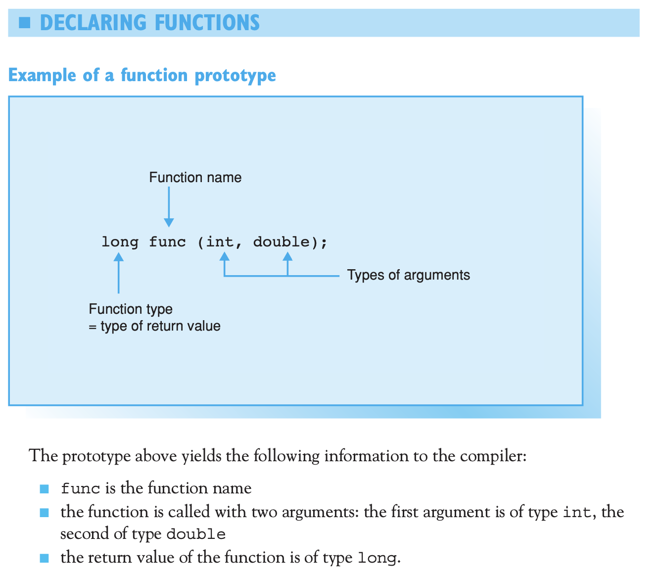
Function Declaration
Notes:
int main(){
for(int i = 0; i<=10;i++){
cout << i << endl;
}
}

Slide 4
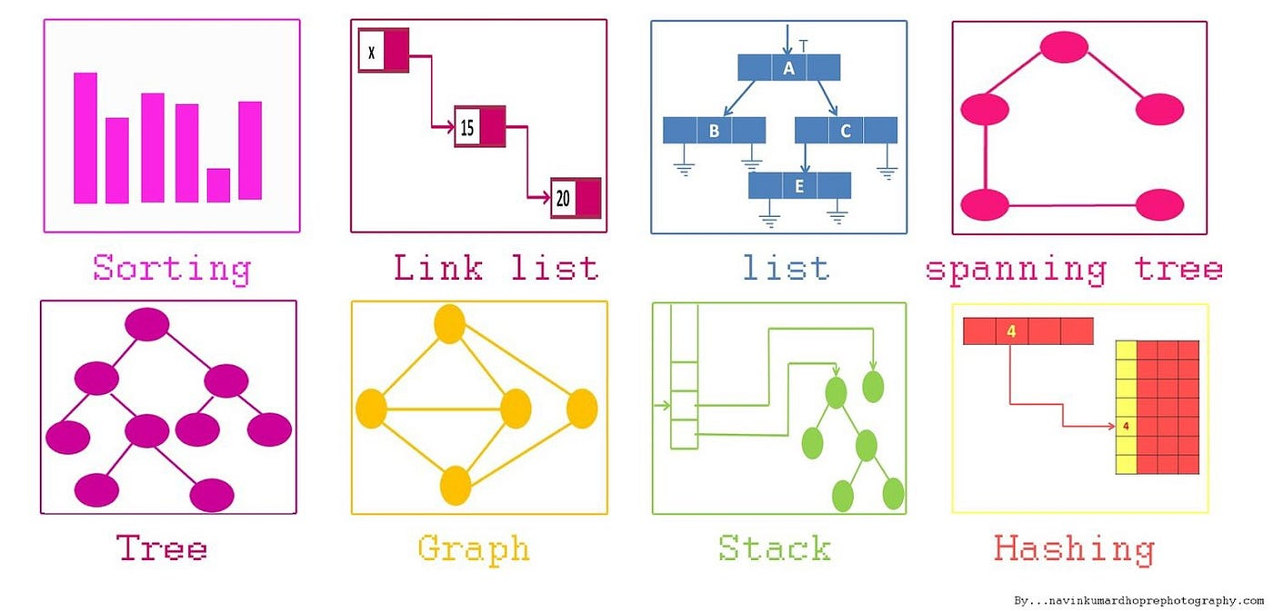
Datastructuren
Data structures are ways to organize, store, and manage data,
focusing on efficiency and executing operations on that data.
They are fundamental concepts in computer science, forming the basis for solving
various programming problems and software development.
Notes:
int main(){
for(int i = 0; i<=10;i++){
cout << i << endl;
}
}

Slide 5
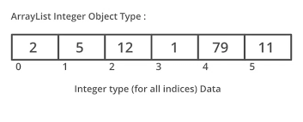
Introduction Array
An array is a data structure that stores a fixed-size sequential collection of elements of the same type.
Notes:
int main(){
for(int i = 0; i<=10;i++){
cout << i << endl;
}
}

Slide 6
Zero-based index
In an array:
array[0] refers to the first element.
array[1] refers to the second element.
array[n] refers to the nth element.
Notes:
int main(){
for(int i = 0; i<=10;i++){
cout << i << endl;
}
}

Slide 7
Data Type size_t
Characteristics:
- Only Positive Values: It can only hold positive (non-negative & zero) values.
- Sufficient Size: It's guaranteed to be large enough to hold the size of any object that can exist in memory.
Notes:
int main(){
for(int i = 0; i<=10;i++){
cout << i << endl;
}
}

Slide 8
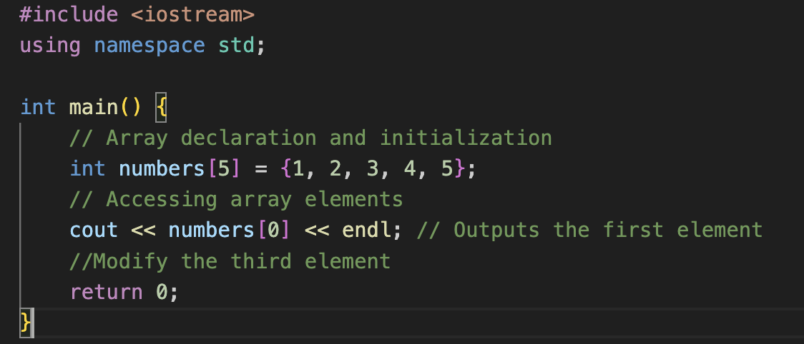
Introduction Array
Notes:
int main(){
for(int i = 0; i<=10;i++){
cout << i << endl;
}
}

Slide 9
Excercise
1. Write a program to find the largest element in an array.
2. Implement a function to reverse the elements of an array.
3. Create a program to merge two sorted arrays into a single sorted array.
4. Develop a function to check if a given element exists in an array
Notes:
int main(){
for(int i = 0; i<=10;i++){
cout << i << endl;
}
}

Slide 10


Slide 11
Vragen?

